Slide 1
Sales Prediction
Presenters:
Chandrasekhar Muthyala - 01088628
Puneeth Bikkasandra - 01101060
December 06, 2018

Slide 2




Index
Introduction
Objective
Data Description
System Design
Modeling
Evaluation Metrics
Conclusion

Slide 3
Introduction
To predict business performance in the shopping outlets
Tool for budgeting and setting expectations
Allows companies to gauge the interest in their products
Helps companies setting projections for the next quarter
Helps in creating promotions that drive more business
Objective
Predict the sale of the particular product in a specific outlet

Slide 4
Data Description
10 stores in different cities , 1559 unique products
12 attributes
Item_Identifier
Item_Weight
Item_Fat_Content
Item_Visibility
Item_Type
Item_MRP
7. Outlet_Identifier
8. Outlet_Establishment_Year
9. Outlet_Size
10. Outlet_Location_Type
11. Outlet_Type
12. Item_Outlet_Sales

Slide 5
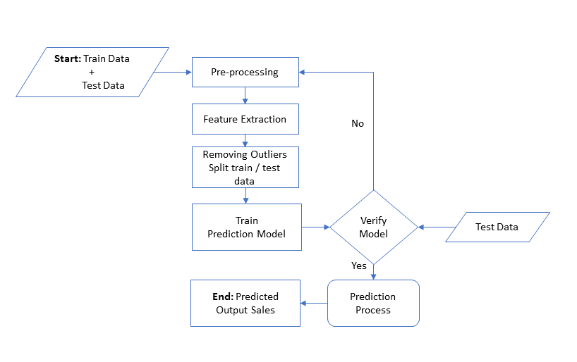
System Design

Slide 6
Pre-processing
Removing duplicate column values and data imputation.
Item Fat Content | Count
Low Fat | 8485
Regular | 4824
LF | 522
reg | 195
low fat | 178
Item Fat Content | Count
Low Fat | 9185
Regular | 5019
Converting categorical values to Numerical values
Combine Product types
Item Type | Categories
Fruits, vegetables, soft drinks, dairy, snack, frozen etc., | 16
Item Type | categories
Food Non-consumable Drinks | 3

Slide 7
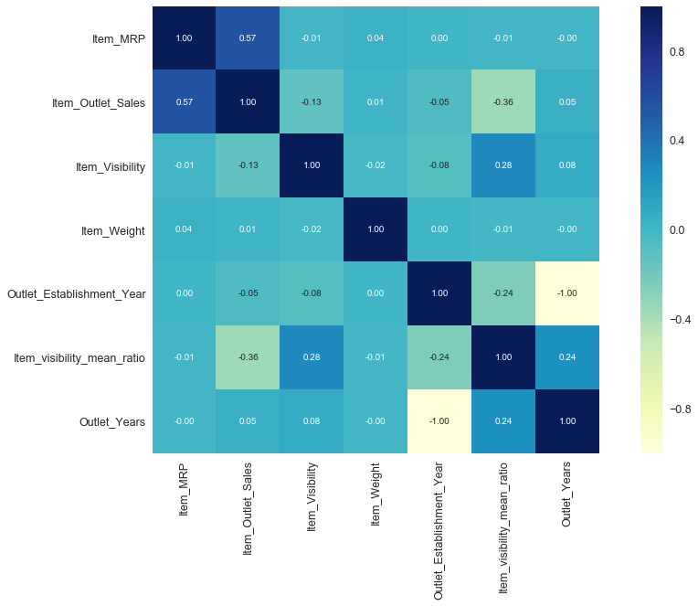
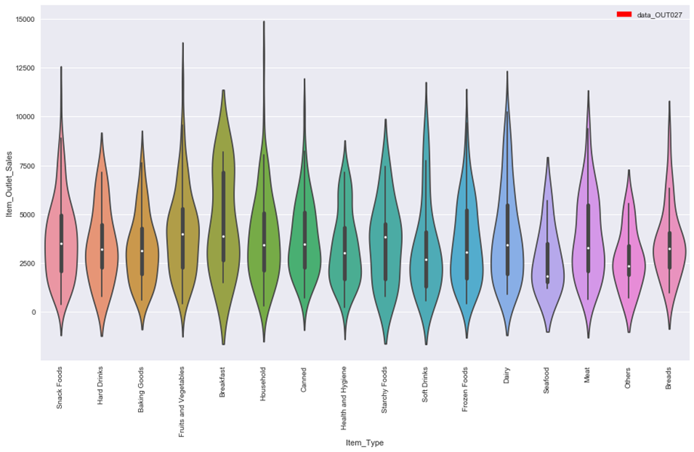
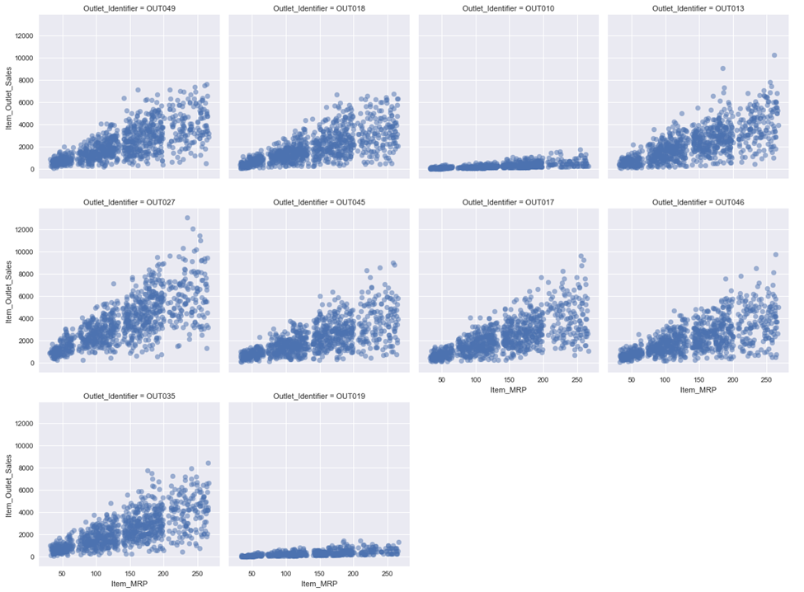
Data Visualization
Violin Plot
Item Type Vs Sales
Scatter plot
Item MRP Vs Sales
Correlation plot

Slide 8
Modeling techniques
Linear Regression
Ridge Regression
AdaBoost Regressor
Decision Tree Regressor
Random Forest Regressor

Slide 9
Evaluation Metrics
Model Name | RMSE | Cross Validation Score
 |  | Mean | Std | Min | Max
Linear Regression | 1128 | 1129 | 43.88 | 1075 | 1210
Ridge Regression | 1129 | 1130 | 44.63 | 1076 | 1217
AdaBoost Regressor | 1147 | 1159 | 40.96 | 1085 | 1230
Decision Tree Regressor | 1151 | 1250 | 43.05 | 1184 | 1344
Random Forest Regressor | 1147 | 1247 | 45.92 | 1164 | 1346

Slide 10
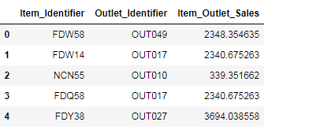
Conclusion
After testing the model for 5 algorithms: Linear Regression outperformed others
Model result:
RMSE: 1128
Sample output :

Slide 11
References
[1] Pandas (2018) Pandas Library. [Online]. URL: https://pandas.pydata.org/
[2] Matplot (2018) Matplotlib Library. [Online]. URL: https://matplotlib.org/
[3] Seaborn. (July 2018) statistical data visualization. [Online].
URL: https://seaborn.pydata.org/
[4] Numpy, Python Numpy Tutorial. [Online].
URL: http://cs231n.github.io/python-numpy-tutorial/
[5] Kaggle. (2018) Data Exploration and Price Prediction, House Sales. [Online].
URL: https://www.kaggle.com/fg1983/data-exploration-and-price-prediction-house-sales
[6] Columbia University, A Data-Cleaning Tool for Building Better Prediction Models. [Online].
URL: https://datascience.columbia.edu/data-cleaning-tool-building-better-prediction-models

Slide 12
Thank You

Slide 13
Data
Pre-Processing
No
Feature Extraction
Verify Model
Train
Classification Model
Test
Data
Yes
Finalized
Model

